Slide 1
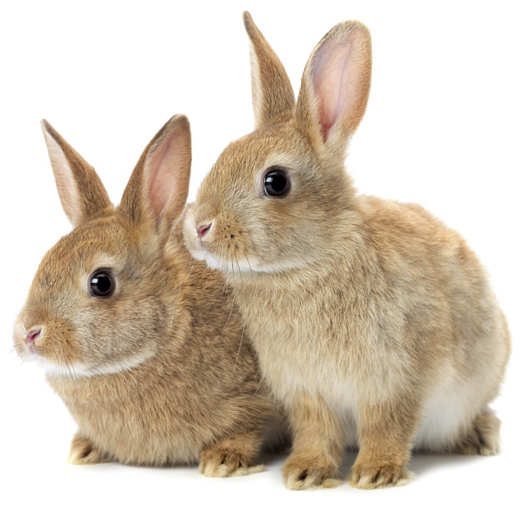
The Cost of Keeping a Pet

Slide 2
Learning Objectives
I will learn all the things you need to consider before getting a pet.
I will learn that people are responsible for taking care of their pets.
I will learn roughly how much pets cost to look after.
Learning Outcomes
P
I can talk about what things people need to consider before getting a pet.
I can state who is responsible for looking after pets.
I can add up amounts using a shopping list.

Slide 3
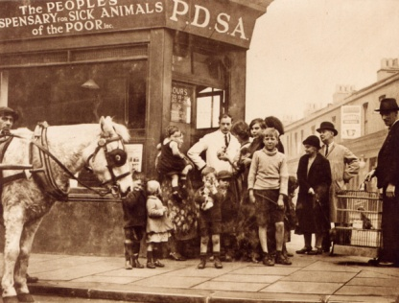
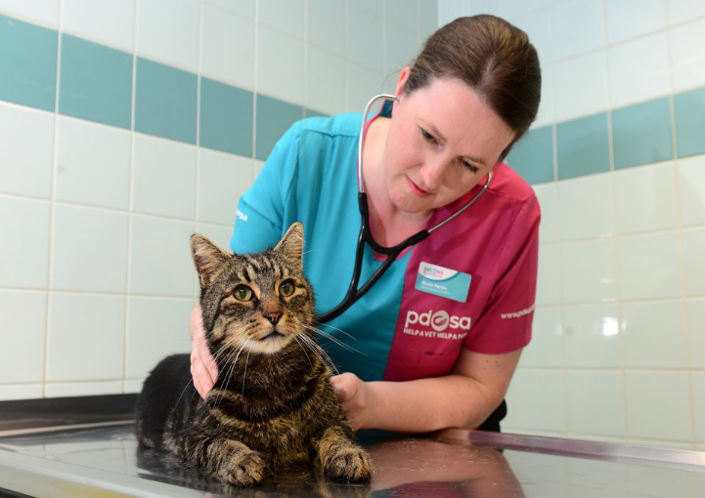
The UK’s leading vet charity …
PDSA is a 100 year old charity who have been treating sick and injured pets since 1917
They have Pet Hospitals all over the UK
They help one sick or injured pet every 5 seconds!
It costs the charity more than
£1 million every week to do their work
Notes:
Share the details on the slide and:
Tell children that PDSA treat the sick and injured pets of people in need..
Ask them if they think it’s important to help sick and injured animals to get better.
Explain that PDSA is a special kind of vets, because they’re a charity. Ask them what a charity does and explain that PDSA looks after pets when owners can’t afford vet treatment.
Ask them what would happen to all the sick and injured pets PDSA treat if they weren’t around.

Slide 4
My Pets
Notes:
Tell the children about your pet(s) and share funny stories about them.
Children have 30 seconds to tell the child next to them a funny story about their pet. If the child doesn't have a pet they could choose one from tv/film.
Hear a few responses from class.

Slide 5
A HOME
EXERCISE & FUN
HEALTH
FOOD
& WATER
FRIENDS
What do pets need?…
Notes:
All pets, whether they’re large or small, need the same five things to keep them healthy and happy:
The right kind of safe, warm home with lots of space
The right kind of food and 24 hour access to fresh water
Exercise and fun (the chance to show normal behaviour)
Friends (This can be other animals, people, or both)
Health ( We all need to make sure our pets are kept healthy and take them to the vet when they’re not well)
Ask whose responsibility it is to keep pets healthy and happy and confirm that owners are responsible for looking after their pet properly.

Slide 6
Think about …
P
LACE
E
XERCISE
T
IME
S
PEND
What do you need for your pet?
Notes:
Ask the pupils to guess what each letter stands for – use the image to support.
Place & Exercise
How much space do you have for your pet? You might have the right type of enclosure for it, but does it have room to run around and exercise? Although this can be an issue for animals of any size, larger animals need lots of space and just because you have a cage that your large cat fits in doesn’t mean that it’s getting the exercise it needs to stay healthy and happy.
Also, if you’re thinking of getting a dog, remember, they need to have at least two walks a day and time off the lead to run and play. Can you give them that?
Time
Pets take up lots of time and you need to make sure you can give them what they need. You’ll need time for feeding, cleaning and exercising, but you’ll also need to not leave them on their own for long periods of time. Can you do that?
Spend
Pets are expensive and even if you know you can buy the equipment and food you need, have you thought about vet bills? They’ll need to go at least once a year for vaccinations, worming etc, but more if they get poorly. The best pet owners make sure they get insurance for their pets in case they get sick. Can you do that?

Slide 7
and last but not least …
DO YOUR HOMEWORK!
Notes:
Compare to the pupils doing their homework. E.g. If they didn’t do their Maths homework before a test, they might not pass or if they’ve missed a day of school, they need to catch up as they may have missed important information.
No matter what type of animal you decide on, be sure to do some research before you get them, to make sure you know what they need to be healthy and happy.
Remember, that having a pet is a big responsibility. They are living creatures with needs that are similar to ours and they deserve the best life we can give them.
Unfortunately, rescue centres are full to bursting with pets that have been given up, either because their owners didn’t realise how much time, money and care they needed or because they got the wrong type of pet for them.
Make sure you do everything you can to be a responsible owner and give your pets a forever home.

Slide 8
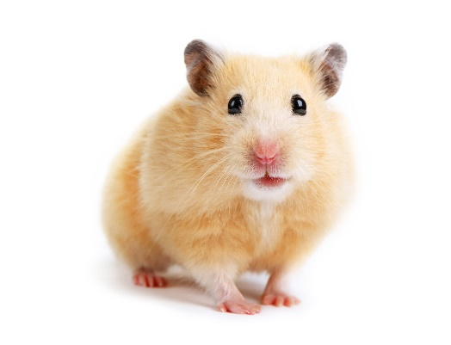
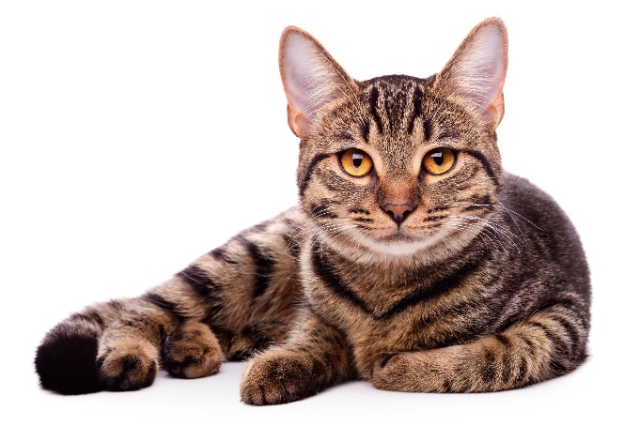
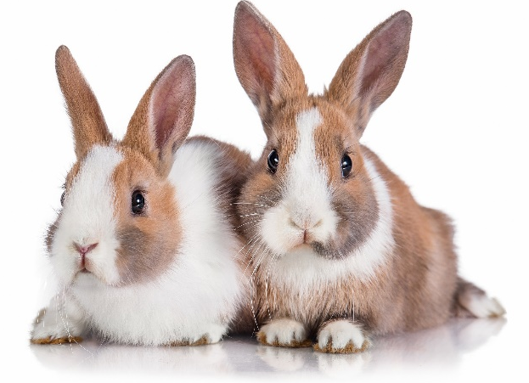
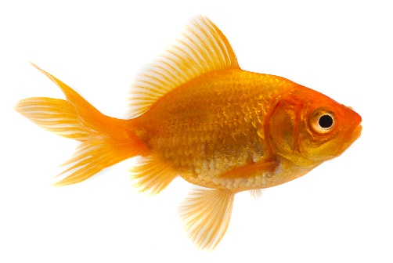
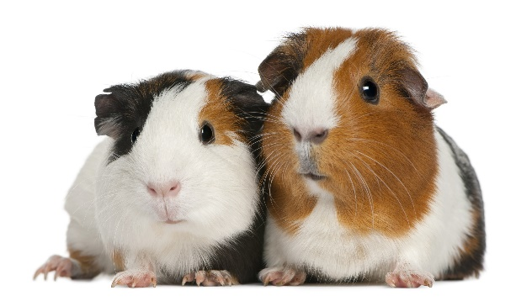
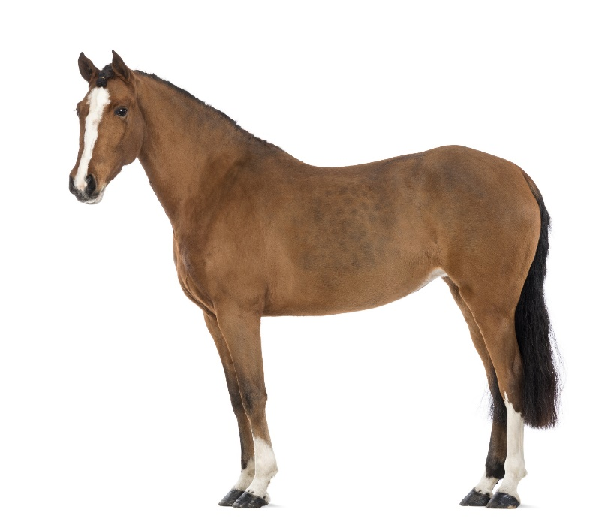
Class pets
No pets
Other
Notes:
Ask the class what pets they have.
This can be done in a number of ways depending on what outcome you want from the activity.
If this session was booked as a Maths focussed session, you may want to use the tally template sheet and get the children to walk around the class (either individually or in pairs) asking each other what pet they have.
You could do a class vote on each image and ask the pupils to tell their partner about their pet for 30 seconds and then hear responses.
Ask the pupils some questions following the task about their findings, such as:
What is the most/least popular pet in their class?
How many pupils own a cat/dog/rabbit? (there should have the same amount if they’ve asked every child in the class)
How many pupils don’t own a pet at all?
Notes:
- If the room is cramped they could do the tally just in their groups rather than the whole class.
If one pupil has multiples of one pet they should still only put one tally mark (otherwise you may end up with hundreds in the fish column!)
You may need to show them how to do a tally

Slide 9
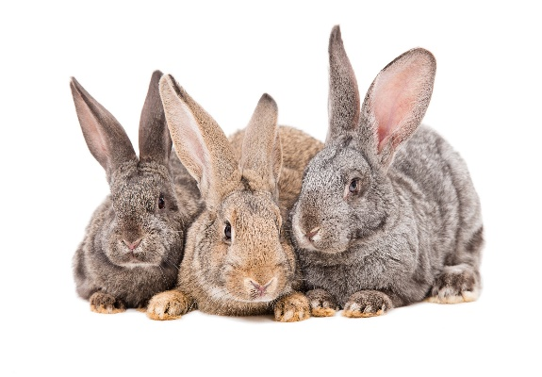
25%
2%
of the UK population have a cat
of the UK population have a rabbit
25%
of the UK population have a dog
Notes:
Explain that cats, dogs and rabbits are the most popular pets in the UK and at our PDSA hospitals.
Ask if anyone knows how much 25% is (a quarter, one in four or 0.25). If they don’t know get 4 volunteers out at the front and give one of them a plush cat or dog.
Estimated numbers from 2017 Paw:
10.3 million cats
9.3 million dogs
1.1 million rabbits

Slide 10
Dogs need…
A safe and warm home with a loving family
To have fun playing with toys and spend time with other dogs
The company of
people and to be
not left alone for
more than 4 hours
To have good quality food and 24 hour access to water
To be neutered, vaccinated and
treated for worms
and fleas
To have at least two walks a day and time off the lead to run and play
Notes:
Explain what a dog needs to stay happy and healthy. You could illustrate some of the points with props. You could ask them to show you the actions if you introduced them on slide 4 or if this session follows Get PetWise.

Slide 11
A. £5,000 - £10,000
B. £10,000 - £15,000
C. £20,000 - £25,000
Average lifetime costs …
Notes:
The baseline cost to own a large dogs can be anything between £7,400 and £17,000. The actual cost of dog ownership is likely to be significantly higher once extra costs such as veterinary treatment, boarding fees, grooming and replacing accessories are taken into account. Additional costs to this baseline can be extremely variable from pet to pet and owner to owner. Whilst it’s difficult to give a total cost of lifetime pet ownership, an estimate including some of these costs could bring the potential lifetime cost of dog ownership up to £33,000 depending on the size and breed of the dog.

Slide 12
A. £5,000 - £10,000
B. £10,000 - £15,000
C. £20,000 - £25,000
Average lifetime costs …
Notes:
For the basic needs of a small dog to be met, you would need to spend between £6,500 and £12,000. That’s a minimum annual cost of £840.

Slide 13
Cats need…
A safe and warm home with a loving family
To practise their hunting skills by playing with toys
The company of
people with space away from other animals
To have good quality food and 24 hour access to water
To be neutered, vaccinated and
treated for worms
and fleas
A scratching post to allow them to stretch, exercise and keep their claws trim.
Notes:
Explain what a cat needs to stay happy and healthy. You could illustrate some of the points with props. You could ask them to show you the actions if you introduced them on slide 4 or if this session follows Get PetWise.

Slide 14
A. £5,000 - £10,000
B. £15,000 - £20,000
C. £20,000 - £25,000
Average lifetime costs …
Notes:
Cats cost approximately £12,000 dependent on life expectancy. To ensure your cat has their five welfare needs covered, you would need to spend in excess of £840 per year.
The actual cost of cat ownership is likely to be significantly higher once extra costs such as veterinary treatment, boarding fees, grooming and replacing accessories are taken into account. Additional costs to this baseline can be extremely variable from pet to pet and owner to owner. Whilst it’s difficult to give a total cost of lifetime pet ownership, an estimate including some of these costs could bring the potential lifetime cost of cat ownership to around £24,000.

Slide 15
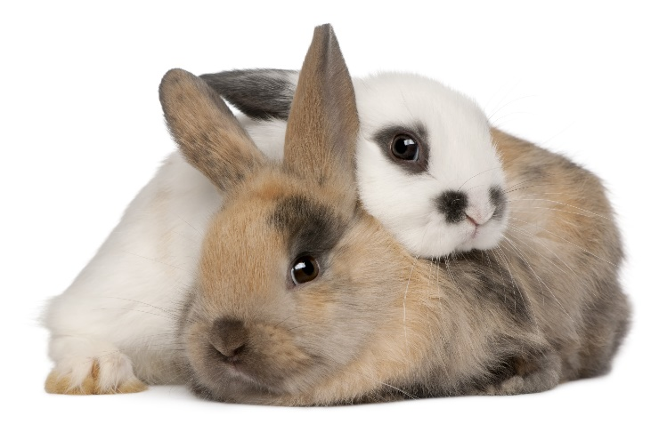
Rabbits need…
At least one other
rabbit friend to live with
To be neutered so they don’t have lots of babies
A large, clean and safe hutch with a large separate exercise area
A diet of rabbit nuggets, a few fresh greens and their own body-size in feeding hay each day
A vet check-up at least once a year and vaccinations
Lots of space to run, jump, play and dig
Notes:
Explain what rabbits need to stay happy and healthy. You could illustrate some of the points with props. You could ask them to show you the actions if you introduced them on slide 4 or if this session follows Get PetWise.

Slide 16
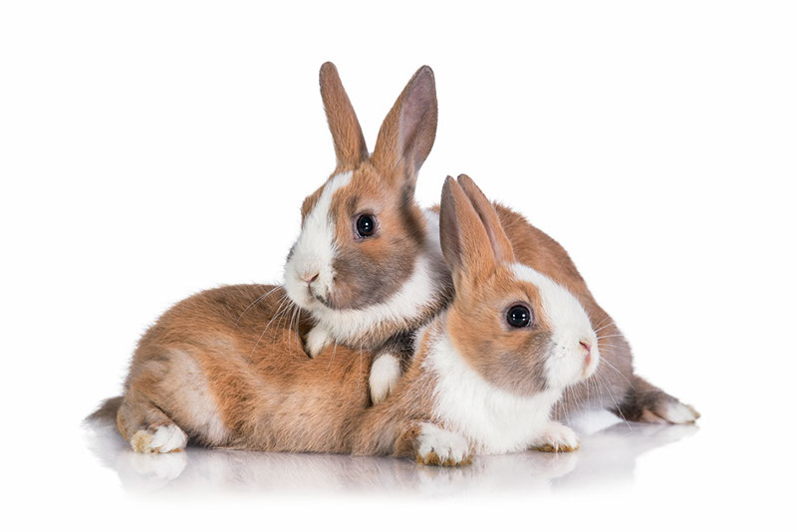
A. £1,000 - £5,000
B. £5,000 - £10,000
C. £10,000 - £15,000
Average lifetime costs …
Notes:
A pair of rabbits would cost between £6,500 and £9,000 during their lifetimes.
Discuss – and remember you need a minimum of two rabbits

Slide 17
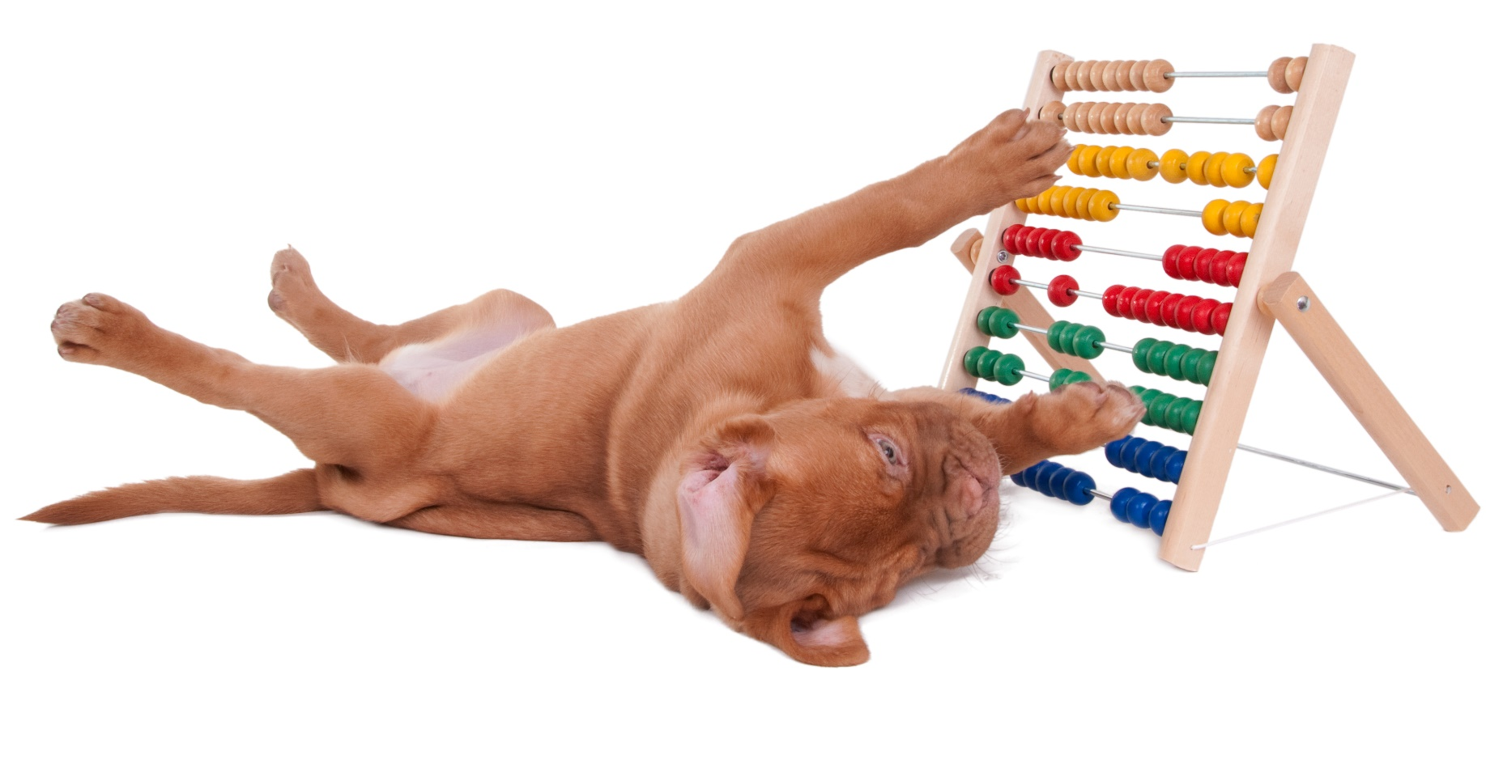
Cost Activity
Notes:
Hand out the shopping list template (one per group) and explain that the pupils will be working out how much some of the basic items cost for each pet. Explain that they may need to use a calculator (depending on age and ability). Low ability children can just write the amounts in without adding them up.
You’ll need to display the following slide during the task.

Slide 18
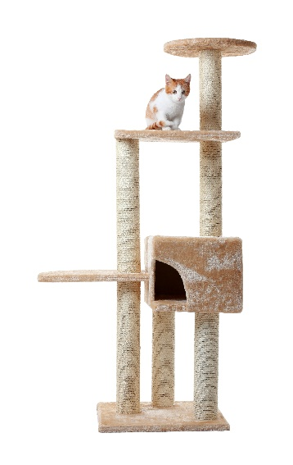
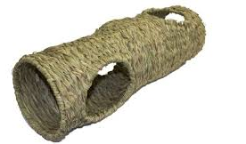
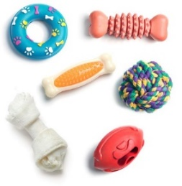
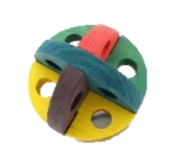
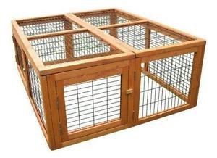
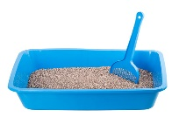
£4.00
£100.00
£3.00
£30.00
£3.00
£15.00
£1.00
£5.00
£7.00
£2.00
£6.00
£6.00
£5.00
£75.00
£2.00
£7.00
Pet Shop
Price List
Notes:
Leave this slide up during the activity. They’ll need this slide in order to fill out their lists.

Slide 19
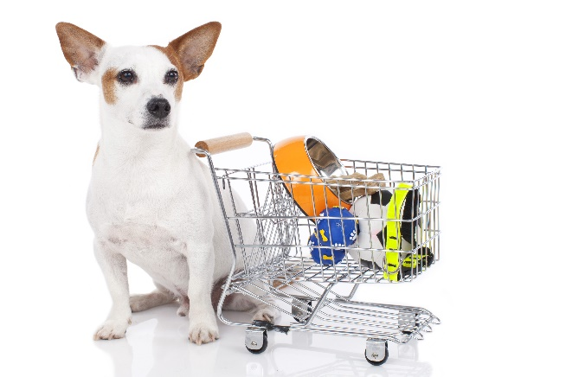
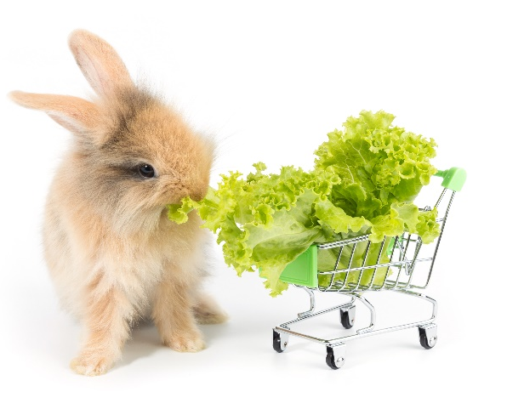
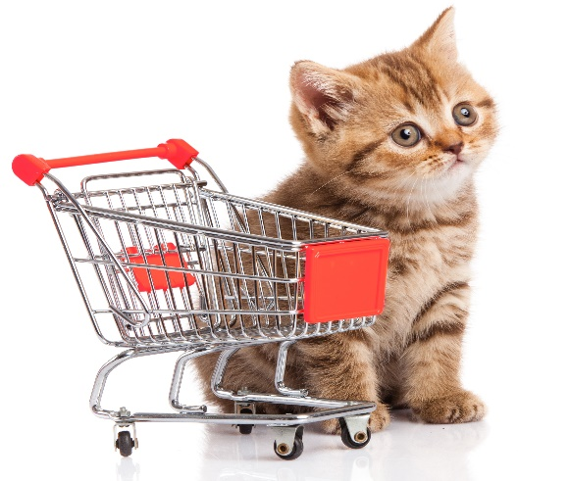
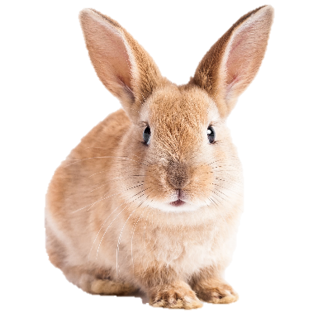
£3.00
£3.00
£3.00
£3.00
£30.00
£30.00
£100.00
£5.00
£1.00
£15.00
£2.00
£30.00
£6.00
£6.00
£3.00
£92.00
£145.00
£3.00
£30.00
£7.00
£5.00
£7.00
£6.00
£6.00
£67.00
Answers
Notes:
Show the total amount for each list and ask the pupils if they got the same answer.

Slide 20
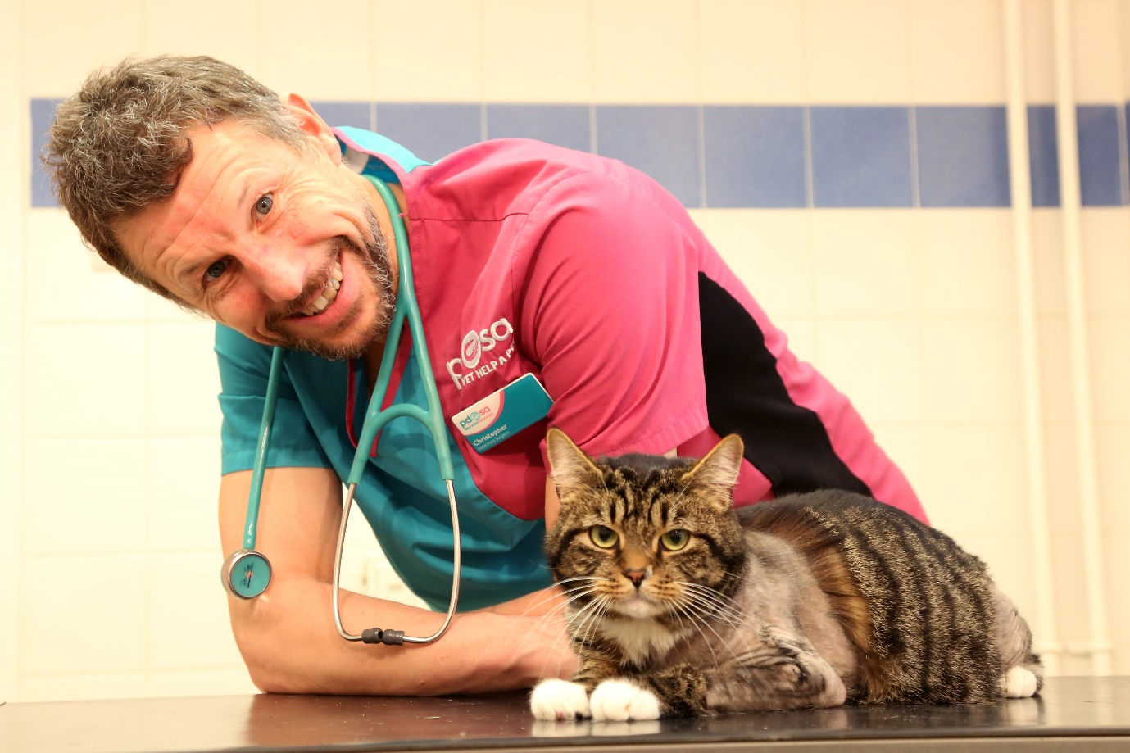
Perci
Notes:
Name: Perci
Species: Feline
Breed: Domestic Short-haired
Colour: Tabby
PDSA Vet : Chris Sherwood
Perci, the two year old tabby cat was rushed to our Leicester Pet Hospital for emergency treatment, when he suffered life-threatening injuries after being hit by a car outside his house. Perci’s injuries were so severe that his owners were warned he may not survive the night. He was given analgesics and was treated for shock and made comfortable, before he could be x-rayed. His x-ray showed that he had broken three of his four legs!
Vet’s comment:
‘Perci suffered terrible injuries in the road accident - it’s rare for a cat to break as many as three legs. Although his injury means he might never be able to use his right back leg fully again, he’s a real fighter and has lots more life in him yet. We’re so pleased he’s making such a brilliant recovery.”
Owner’s comment:
“I’m so grateful to the vets and nurses at the Pet Hospital in Leicester who did everything they could to save Perci. I wanted to give something back, so I set up a fundraising page to help raise money for Perci’s life-saving treatment. With the support of friends and family, we collected an amazing £1,300 for PDSA. I feel really happy that this will help other sick and injured pets, like Perci, who are in need of vet treatment.

Slide 21
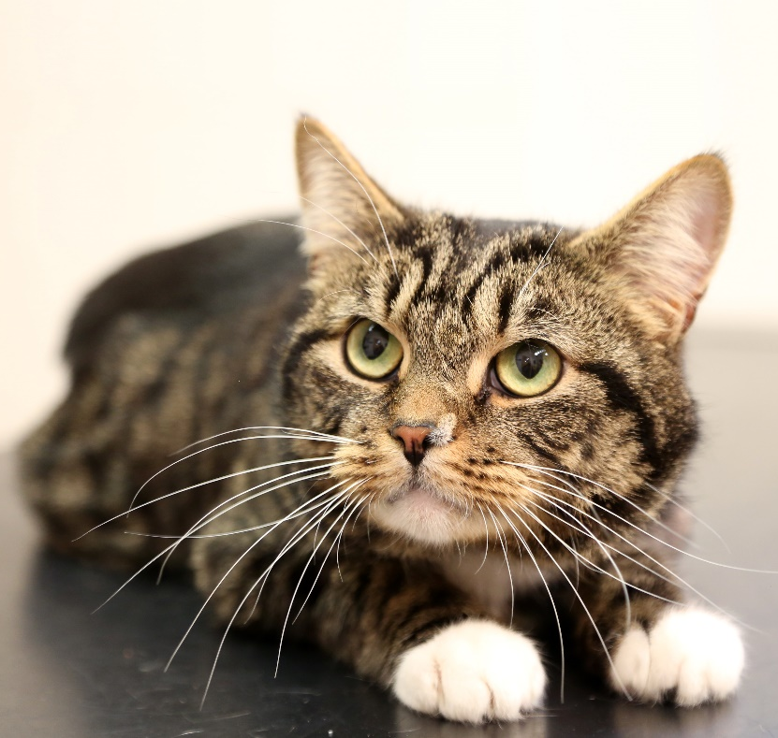
Perci’s Costs
Notes:
Tell the pupils how much Perci’s bill would have cost had his owner had to pay.

Slide 22
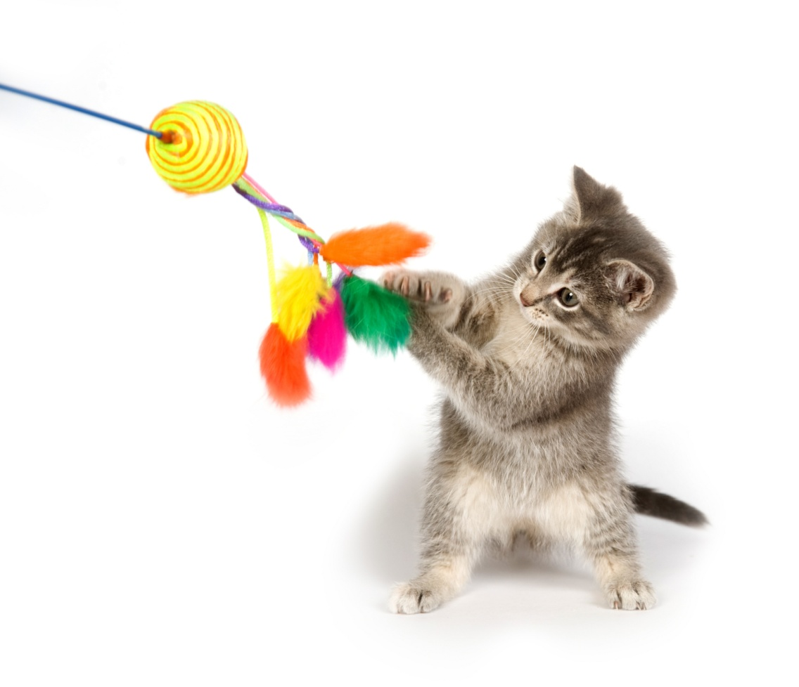
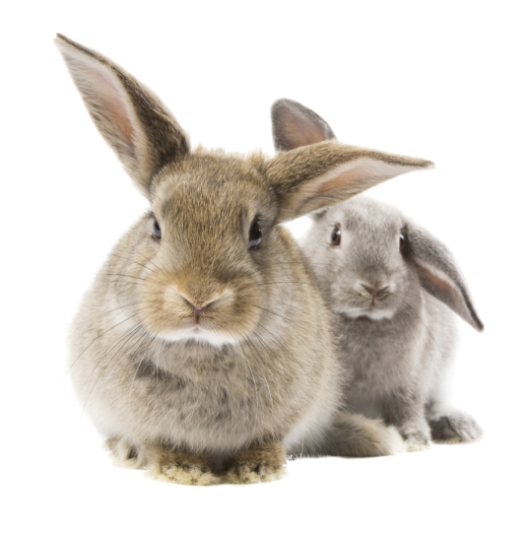
Thanks!

